Slide 1
CASTING TECHNIQUES
وزارة التعليم العالي والبحث العلمي
جامعة ديالى / كلية الهندسة

Slide 2
INTRODUCTION
Basically casting involves the introduction of molten metal into a mold cavity; upon solidification the metal takes the shape of the cavity.
Almost all metals can be cast in the final shape desired, often with only minor finishing required.

Slide 3
INTRODUCTION
Casting process is the most economical process of going from raw material to final product.
It should be the first choice for primary process selection.
Other processes should be selected only when casting cannot meet the desired design requirements.

Slide 5
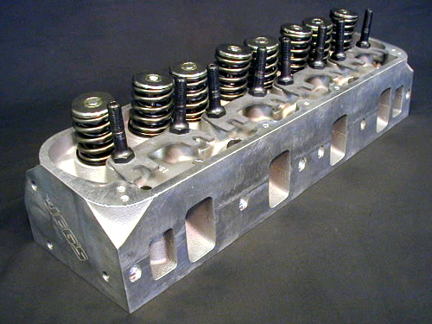
ENGINE BLOCK & CYLINDER HEAD

Slide 6
INTRODUCTION
The objective is to produce castings that are
free from defects &
that meet requirements for strength, dimensional accuracy, & surface finish.

Slide 7
ADVANTAGES
COMPLICATIONS OF SHAPE: this is the only method that can produce complex, 3-d internal & external surfaces simultaneously.
PRODUCT SIZE: very large, bulky products are difficult to manufacture using other processes.
PROPERTIES: The properties of the product is isotropic or non-directional

Slide 8
SHAPES
Casting is an efficient process for producing intricate shapes in a single piece, including shapes with internal cavities
Products may range in sizes from a few millimeters with weights of a few grams, to very large pieces weighing as much as 300 tons.

Slide 9
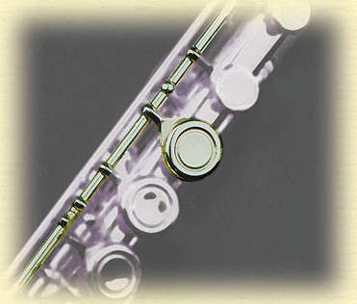
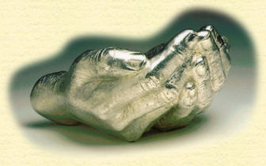
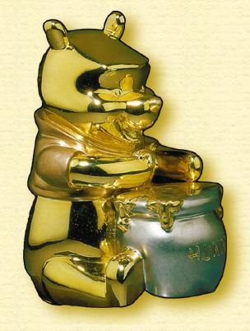
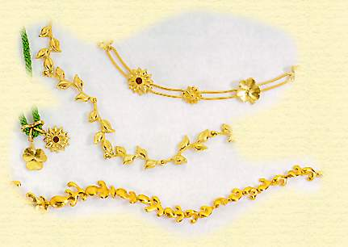

Slide 10
ADVANTAGES
ALLOY PROPERTIES: The alloy may be suitable only for casting.
ECONOMICS: the process is economical for low production & high production rates.

Slide 11
CASTING PROCESS
The basic steps in making sand castings:
Patternmaking
Core making
Molding
Melting and pouring
Cleaning

Slide 12
CASTING PROCESS
The pattern is the replica of the object to be cast. It is usually made of wood or metal or sand.
It is made in two halves which have to be fitted together using dowel pins.

Slide 13
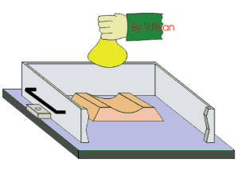
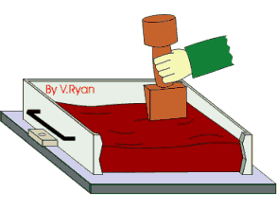
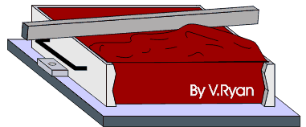
CASTING PROCESS

Slide 14
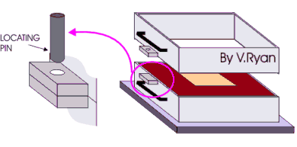
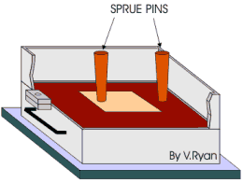
CASTING PROCESS

Slide 15
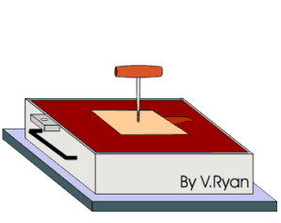
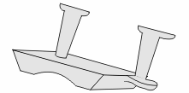
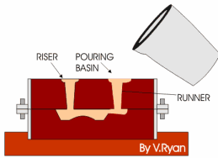
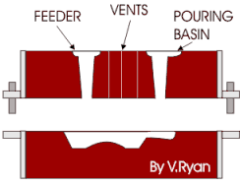
CASTING PROCESS

Slide 16
IMPORTANT FACTORS
Solidification of metal from its molten state (which is usually accompanied by shrinkage)
Flow of molten metal into the mold cavity. (gating system)
Heat transfer/cooling rate during solidification & cooling of the metal in the mold. (cast structure)
Mold material & its influence on the casting process.

Slide 17
Casting processes are generally classified according to
the mold materials,
molding processes &
methods of feeding metal.

Slide 18
PROBLEM
Three pieces of casting have the same volume but different shapes. One is a sphere, one a cube, & other a cylinder with height equal to its diameter. Which one will solidify the fastest?
Ans. Solidification time= C(Vol/surface area)²

Slide 19
SHRINKAGE & POROSITY
Contraction of liquid metal as it cools.
Contraction due to latent heat of fusion as it cools (solidification)
Contraction of the solidified metal as its temperature drops to room temperature.
METAL | VOLUMETRIC SOLIDIFICATION CONTRACTION %
Aluminum | 6.6%
Iron | 4-5.5%
Copper | 4.9%

Slide 20
PROCESS | MATERIALS CAST | SIZE | SURFACE FINISH | POROSITY
Sand | All | 0.05kg-no limit | Bad | Very high
Shell | All | 0.05kg-100kg | Fair | Very high
Plaster | Non-ferrous | o.o5kg-50kg | Good | Medium
Investment | All (High m.p) | 0.1kg-100kg | Fair | Very high
Permanent Mold | All | 0.5kg-300kg | Fair | Fair
Die | Non-ferrous | 0.05kg-50kg | Good | Low
Centrifugal | All | <5000kg | fair | low

Slide 21
PROCESS | SHAPE COMPLEXITY | SECTION THICKNESS | COST | PRODUCTION RATE pc/hr | DIMENSIONAL ACCURACY
Sand | Good | 3mm-no limit | L-M | <20 | Bad
Shell | Good | 2mm-no limit | L-M | <50 | Fair
Plaster | Good | 1mm-no limit | L-M | <10 | Fair
Investment | v.Good | 1mm-75mm | M | <1000 | Good
Permanent Mold | Fair | 2mm-50mm | M-H | <60 | Fair
Die | Fair | 0.5mm-12mm | H | <200 | Good
Centrifugal | Fair | 2mm-100mm | H | <50 | Good

Slide 22
POROSITY
The most undesirable effect of shrinkage is porosity.
When the liquid is unable to reach the regions where solidification is occurring, porosity develops due to shrinkage of solidified metal.
Casting must provide for an adequate supply of liquid metal so that this porosity during cooling/solidification can be avoided.

